Slide 1

CSG2344 Project Methods and Professionalism
Project Management Processes
What are the big lessons the IT industry has learnt about software development?
So how do we organise a software project?
ECU Copyright 2015 – CSG 2344 School of Computer and Security Science

Slide 2
Lecture objectives
To be able to understand the following:
- Where SDLC processes fit into PM
- Project Management processes
- Project Integration Management
- Project initiation
  Prepare a business case for the project
  Create the project charter
  Develop a preliminary scope statement
ECU Copyright 2015 – CSG 2344 School of Computer and Security Science

Slide 3
Review of systems development lifecycles – SDLC
- Characterised by different stages or phases
- A well defined phase has
  a set of activities
  a set of deliverables from these activities
  a set of quality control measures
- Alternative lifecycles may structure the phases differently
  Waterfall
  Prototyping
  Incremental
  eXtreme Programming
  Spiral
ECU Copyright 2015 – CSG 2344 School of Computer and Security Science
Notes:
like biological life cycle
start as a gleam in someones eye…
birth
development
useful life
loss of fitness for purpose ---surgery
death

Slide 4
Generic SDLC phases
Regardless of the lifecycle - certain activities must be done…
problem definition (why)
analysis (what)
design (how)
implementation (how)
testing (how well)
ECU Copyright 2015 – CSG 2344 School of Computer and Security Science

Slide 5
Problem Definition
What is the problem or situation that has given rise to an information system being required ?
- Definition of the problem in user terms
  it is the user’s problem ?
  defining it helps the understanding
- What is the business case for solving the problem?
  information systems are expensive to develop
  there are competing priorities for development
ECU Copyright 2015 – CSG 2344 School of Computer and Security Science

Slide 6
Analysis
- The result of Systems Analysis is the Requirements Specification
- A contract between developer and user…
  - a clear understanding of what the solution shld provide
- What inputs the system will process
- What functions it will perform
- What outputs will be produced
- Response time / other performance requirements
What the system will do
ECU Copyright 2015 – CSG 2344 School of Computer and Security Science

Slide 7
Design
A model of the whole system is developed which will solve the problem
The model can be sub-divided:
  data structure
  software architecture
  human interface
  algorithmic detail
how the solution will be implemented
ECU Copyright 2015 – CSG 2344 School of Computer and Security Science

Slide 8
Implementation (Coding)
- Implementation refers to entering the solution in the code of the selected programming language
- Translate the design into executable programs
  may include code generation
- All code must
  be written according to standards
  be fully documented
- May be constrained by the language / platform to be used
ECU Copyright 2015 – CSG 2344 School of Computer and Security Science

Slide 9
Testing
A variety of test activities performed at this stage to assure the quality of the product eg.
- Unit test - modules tested separately (black box or white box)
- Integration test - modules tested in groups
- System test
- Acceptance test - by the users
not strictly true to show testing as a phase following coding - testing activities occur throughout the lifecycle
ECU Copyright 2015 – CSG 2344 School of Computer and Security Science

Slide 10
Maintenance
Keeping the software operational after it has been successfully installed eg:
fixing bugs
changing functionality required by users
adapting the software for a new environment
perfecting the structure of the code
ECU Copyright 2015 – CSG 2344 School of Computer and Security Science

Slide 11
What else needs to be done?
Project Management!
The SDLC focuses on the software engineering phases, processes, tools and techniques for building the system BUT Project Management focuses on the project management phases, processes, tools and techniques for effectively managing the project.
In other words there are many activities which are not software engineering activities but are project management activities
ECU Copyright 2015 – CSG 2344 School of Computer and Security Science

Slide 12
So how do the two interact?
Treat this as a learning activity.
List what activities in your opinion are PM activities but not SDLC activities?
Then by examining that list, sort them by time i.e. what activities are done at the beginning, middle and end of PM?
You have five minutes for this.
ECU Copyright 2015 – CSG 2344 School of Computer and Security Science

Slide 13
Project Management Processes
Process - a series of actions directed toward a particular result
Initiating processes
Planning processes
Executing processes
Monitoring and Controlling processes
Closing processes
ECU Copyright 2015 – CSG 2344 School of Computer and Security Science

Slide 14
Description of Project Processes
Initiating processes - actions to begin projects
Planning processes - devising a workable scheme to ensure that the project meets its goals
Executing processes - coordinating people and other resources to carry out the project plans and produce the deliverables of the project
Monitoring and controlling processes measure progress toward achieving project goals, monitor deviation from plans, and take corrective action to match progress with plans and customer expectations
Closing processes - formalizing acceptance of the project and bringing it to an orderly end.
ECU Copyright 2015 – CSG 2344 School of Computer and Security Science

Slide 15
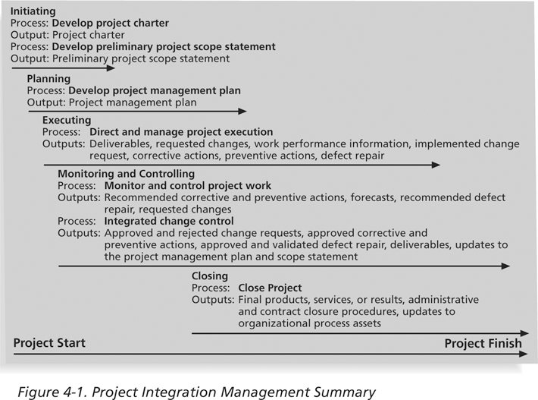
Project Processes Summary

Slide 16
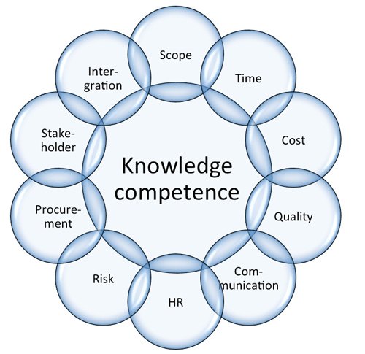
Project Management – Knowledge Areas
ECU Copyright 2015 – CSG 2344 School of Computer and Security Science

Slide 17
The Key to Overall Project Success:
Good Project Integration Management
Project managers must coordinate all of the other knowledge areas throughout a project’s life cycle
Many new project managers have trouble looking at the “big picture” and want to focus on too many details
ECU Copyright 2015 – CSG 2344 School of Computer and Security Science

Slide 18
Project Integration Management Processes
Develop the project charter: working with stakeholders to create the document that formally authorizes a project—the charter
Develop the preliminary project scope statement: working with stakeholders, especially users of the project’s products, services, or results, to develop the high-level scope requirements and create a preliminary project scope statement
Develop the project management plan: coordinating all planning efforts to create a consistent, coherent document—the project management plan
ECU Copyright 2015 – CSG 2344 School of Computer and Security Science

Slide 19
Project Integration Management Processes (continued)
Direct and manage project execution: carrying out the project management plan by performing the activities included in it
Monitor and control the project work: overseeing project work to meet the performance objectives of the project
Perform integrated change control: coordinating changes that affect the project’s deliverables and organizational process assets
Close the project: finalizing all project activities to formally close the project

Slide 20

Initiating Tasks
Prepare a business case for the project
Create the project charter.
Develop a preliminary scope statement.
ECU Copyright 2015 – CSG 2344 School of Computer and Security Science

Slide 21
Preparing a Business Case
Successful organizations initiate projects to meet business needs, and a common business need is to spend money wisely.
A business case is a document that provides justification for investing in a project.
It allows comparisons between potential projects
ECU Copyright 2015 – CSG 2344 School of Computer and Security Science

Slide 22

Contents of a Business Case
Introduction/Background
Business Objective
Current Situation and Problem/Opportunity Statement
Critical Assumptions and Constraints
Analysis of Options and Recommendation
Preliminary Project Requirements
Budget Estimate and Financial Analysis
Schedule Estimate
Potential Risks
ECU Copyright 2015 – CSG 2344 School of Computer and Security Science

Slide 23
Ratio analysis
This term comes from accountancy, where it is common practice for accounting to use ratios (or percentages) to gauge a company's performance in selecting CAPITAL projects such as computer projects.
In selecting a project the ratios are those techniques which allow us to quantify the costs and benefits, ie. ROI, NPV, etc.

Slide 24

Concepts
Present value of money
Payback period
Net Present Value
Return on Investment
Internal Rate of Return
ECU Copyright 2015 – CSG 2344 School of Computer and Security Science

Slide 25
Present value of money
The value of money changes over time. So the value of a dollar to a company today is greater than it will be in a year’s time because of inflation (positive inflation assumed).
In fact the difference is easily calculated by using the inflation rate, although often in most calculations the same inflation rate is assumed throughout!
ECU Copyright 2015 – CSG 2344 School of Computer and Security Science

Slide 26

Present value of money
Example:
What will $1000 be worth in five years time assuming a
discount (inflation) rate of 16%?
5
PV = 1000 / (1 + 0.16)
= 1000 / 2.1368
= $468
ECU Copyright 2015 – CSG 2344 School of Computer and Security Science

Slide 27
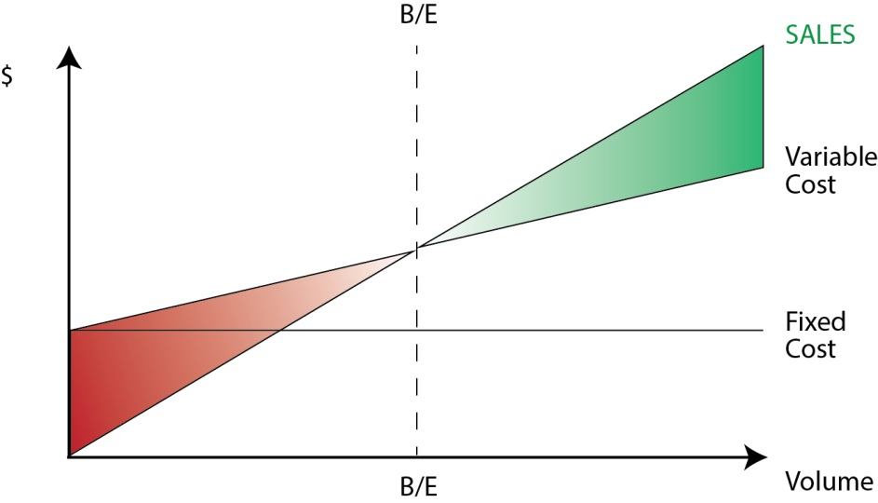
Payback period
This is simply how long it takes for the benefits to pay back the costs using present values. This is done by charting out a table in which the benefits and costs are plotted on a yearly basis and then searching for the breakeven (B/E) point.
ECU Copyright 2015 – CSG 2344 School of Computer and Security Science

Slide 28
Costs and benefits
When quantifying costs and benefits it is usual to do this based on the marginal contribution.
The marginal contribution is the difference between the total current costs and benefits and the total future ones
For example, if you are shifting from a manual system to a computerised one you will have current costs and benefits in the manual one and these have to be taken away from any future costs and benefits.
ECU Copyright 2015 – CSG 2344 School of Computer and Security Science

Slide 29
Net Present Value
Net Present Value (NPV) is simply the sum of the net present benefits minus the sum of the net present costs over the life of the project. Note that costs are often incurred before the benefits arise and so the time value of money becomes important.
Note - If NPV is positive then the project is viable.
ECU Copyright 2015 – CSG 2344 School of Computer and Security Science

Slide 30
Return on Investment
Return on Investment (ROI) is the percentage obtained from dividing the net present costs by the NPV
For example say:
Net present benefit = 176474
Net present cost = 110551
ROI = (176474 - 110551)/110551 = 60%
ECU Copyright 2015 – CSG 2344 School of Computer and Security Science

Slide 31

Internal Rate of Return
Internal Rate of Return (IRR) is the average discount rate required to make the net costs equal to the net benefits. It can be worked out from ROI.
Suppose ROI was 60% and the life of the project was five years. IRR is 12%
Companies usually have a minimum value for accepting projects. So if this was 15%, the project proposal would be rejected.
ECU Copyright 2015 – CSG 2344 School of Computer and Security Science

Slide 32
The Business Case has been approved, but…this is just the start….
Who is the project manager?
Who is the project sponsor?
Who is on the project team?
What role does everyone associated with the project play?
What is the scope of the project?
What resources and technology will be required?
What approach, tools and techniques will be used to develop the information system?
What tasks or activities will be required to perform the project work?
How long will these tasks or activities take?
Who will be responsible for performing these tasks or activities?
ECU Copyright 2015 – CSG 2344 School of Computer and Security Science

Slide 33
Creating a Project Charter
A project charter
  is a document that formally recognizes the existence of a project and provides a summary of the project’s objectives and management.
  It authorizes the project manager to use organizational resources to complete the project.
A crucial part of the project charter is the sign-off section.
ECU Copyright 2015 – CSG 2344 School of Computer and Security Science

Slide 34
Contents of a Project Charter
Project Title and Date of Authorization
Project Start Date/Finish Date
Other Schedule Information
Budget Information
Project Manager
Project Objectives
Approach
Roles and Responsibilities
Sign-off
Comments
ECU Copyright 2015 – CSG 2344 School of Computer and Security Science

Slide 35
Preliminary Scope Statement
A scope statement is a document used to develop and confirm a common understanding of the project scope.
It describes in detail the work to be accomplished and is an important tool for preventing scope creep—the tendency for project scope to continually increase.
It is helpful to create a preliminary scope statement during project initiation so that the entire project team can start discussions and work related to the project scope.
There are usually several versions, and each one becomes more detailed as the project progresses and more information becomes available.
ECU Copyright 2015 – CSG 2344 School of Computer and Security Science

Slide 36
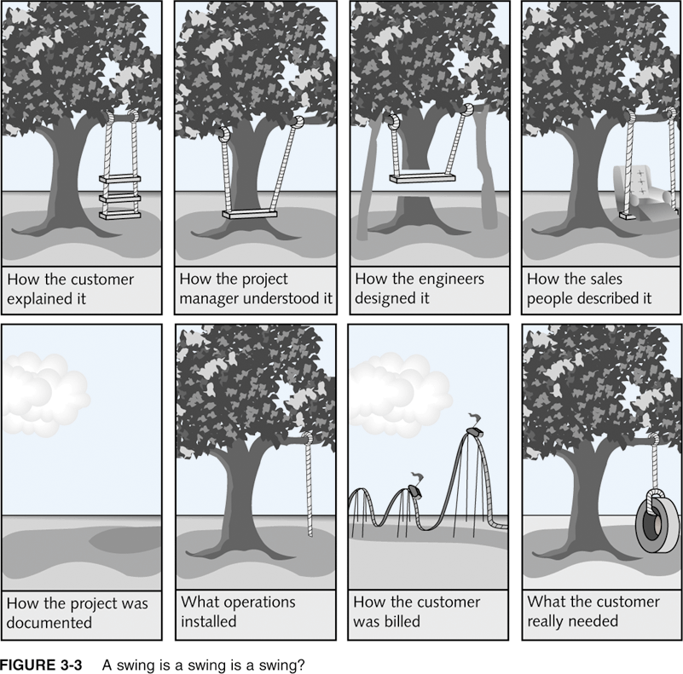
A Swing is a Swing is a Swing?

Slide 37
Contents of a Scope Statement
Contents and length will vary based on the project.
Typical contents include:
  Requirements and characteristics
  A summary of all deliverables
  The project success criteria
  References to related documents
ECU Copyright 2015 – CSG 2344 School of Computer and Security Science

Slide 38

Lecture Summary
SDLC processes
Project Management processes
Project Integration Management
Project initiation
  Prepare a business case for the project
  Create the project charter
  Develop a preliminary scope statement
ECU Copyright 2015 – CSG 2344 School of Computer and Security Science

